Slide 1
Neuro-Plasticity
Whether is it a blessing or curse for society?
-Rawat Dhaval

Slide 2
Research questions:
What is Neuro Plasticity?
How it works?
Why it should be placed on tongue?
Limitations

Slide 3
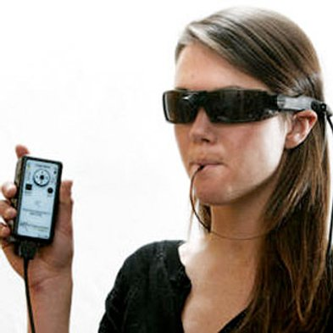
Reality:
Neuroscientist Paul Bach-y-Rita hypothesized in the 1960s that "we see with our brains not our eyes." Now, a new device trades on that thinking and aims to partially restore the experience of vision for the blind and visually impaired by relying on the nerves on the tongue's surface to send light signals to the brain.

Slide 4
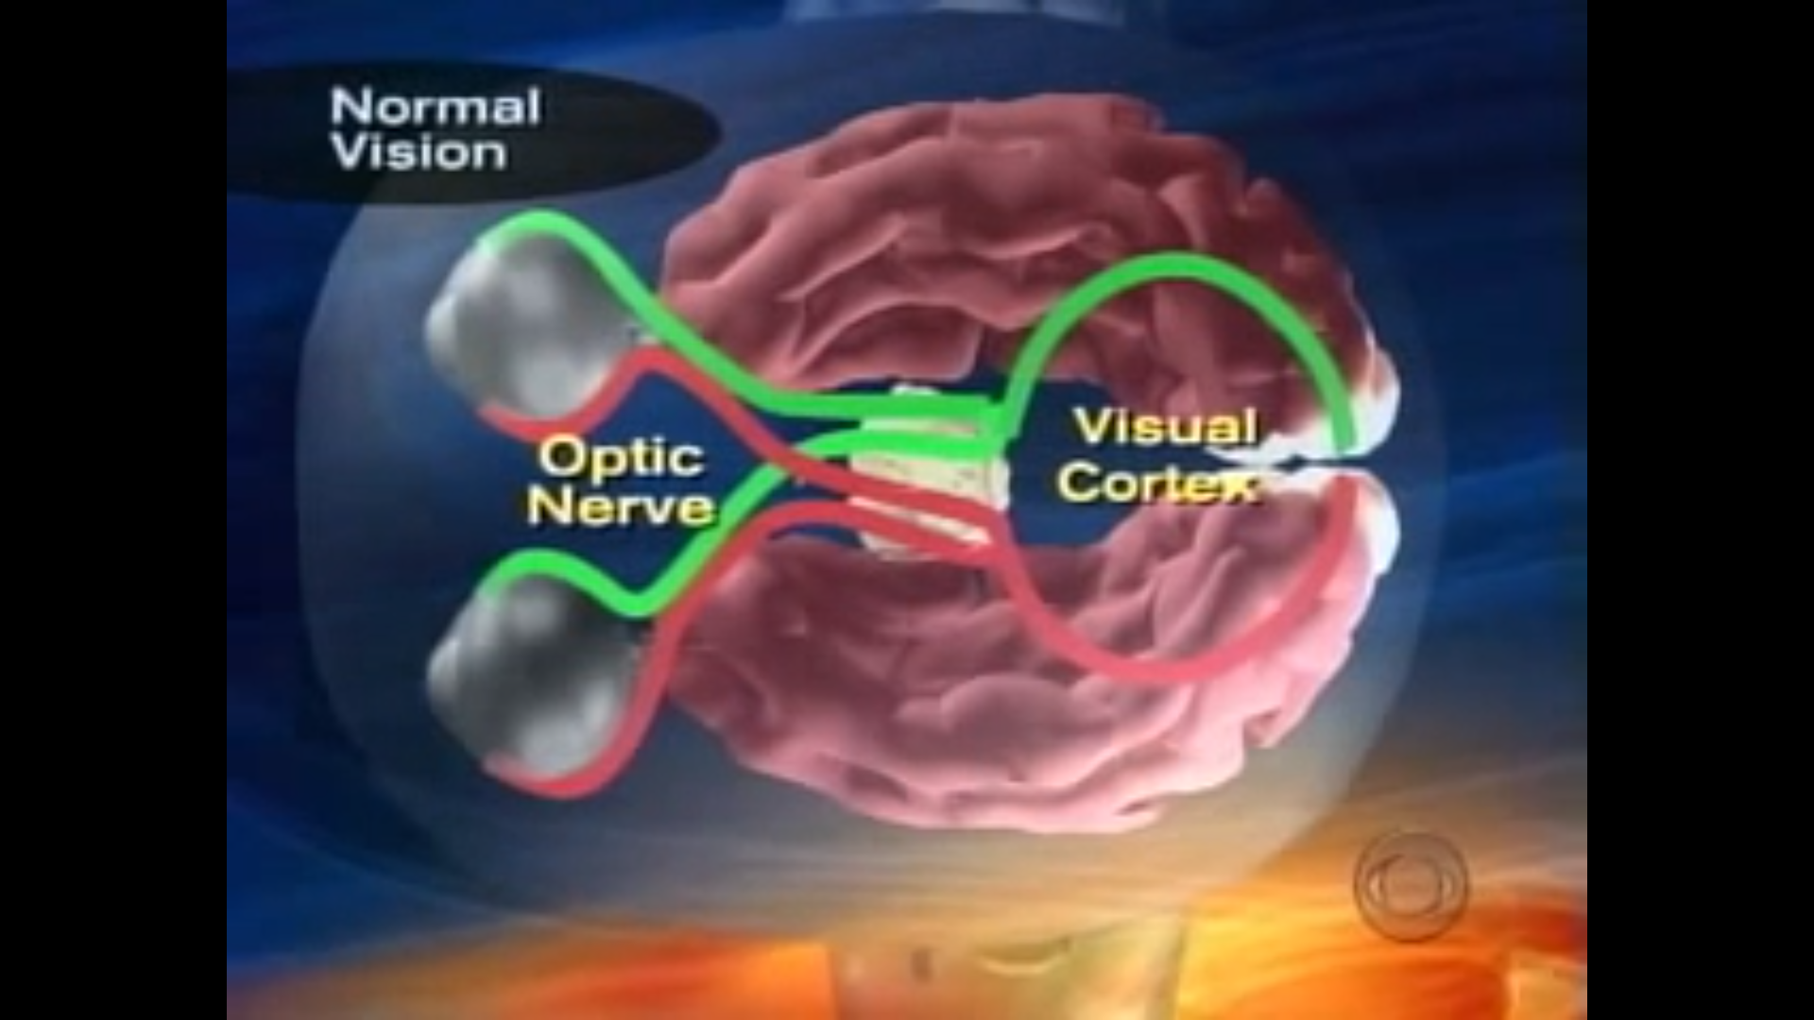
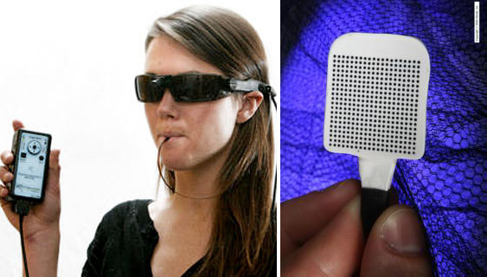
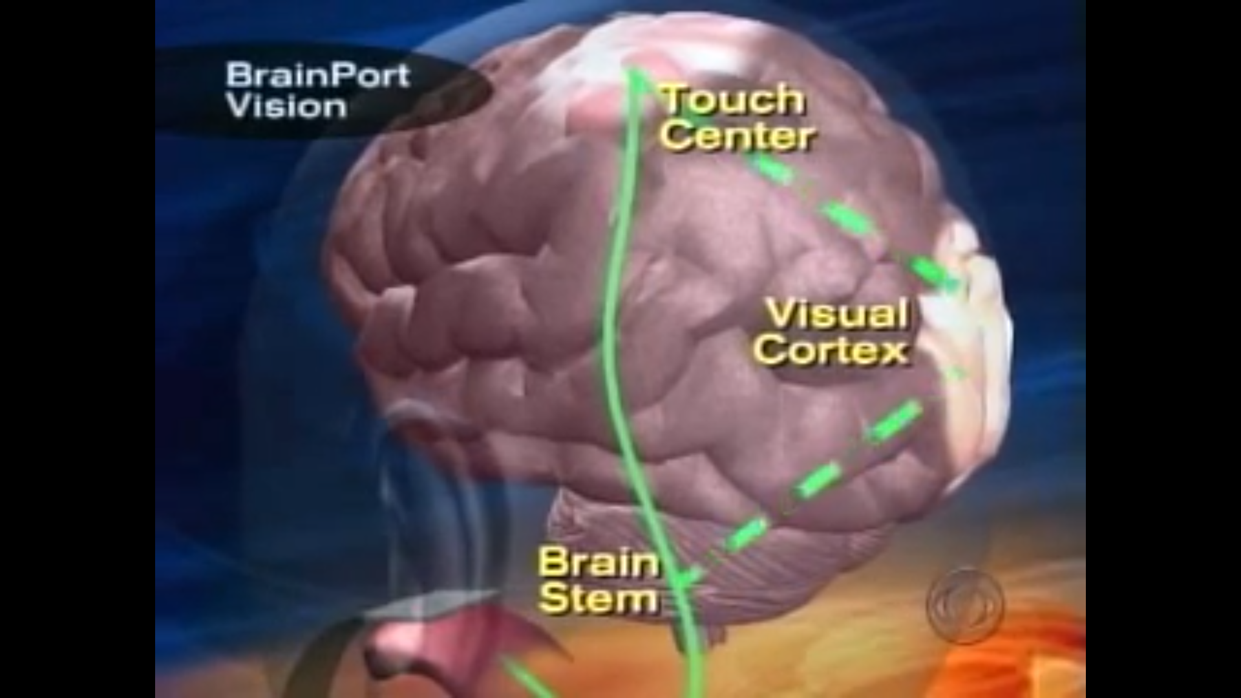
Neuroplasticity - concept
In normal vision, an eye send signals to the middle of the brain. From there the signals are sent directly to the visual cortex at the back of the brain. Not so for the blind.
The brain port retrains the way that brain processes information by first stimulating the tongue with a ray of tiny electrodes.
The nerves in the tongue send signals through a different path way to the brain stem and the area that deals with touch.
Eventually the blind person learns to interpret touch as sight in the visual cortex.

Slide 5
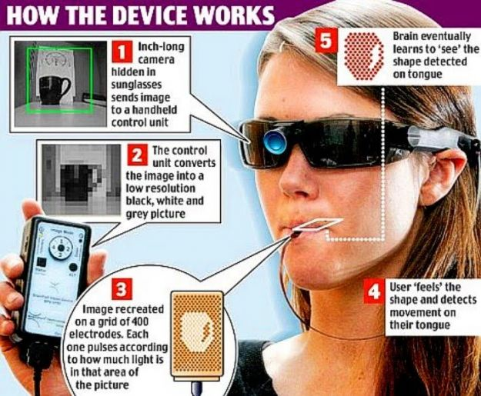
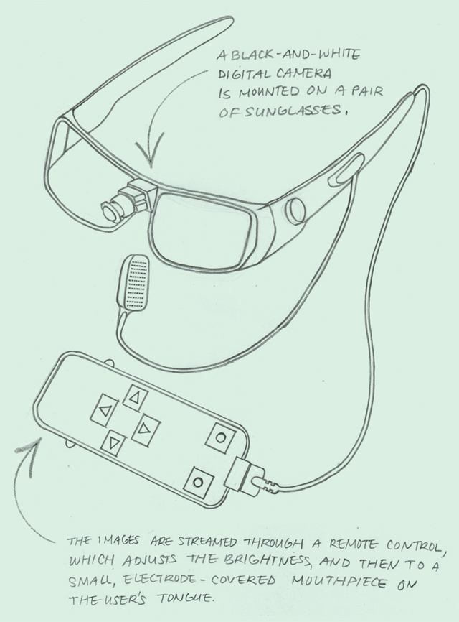
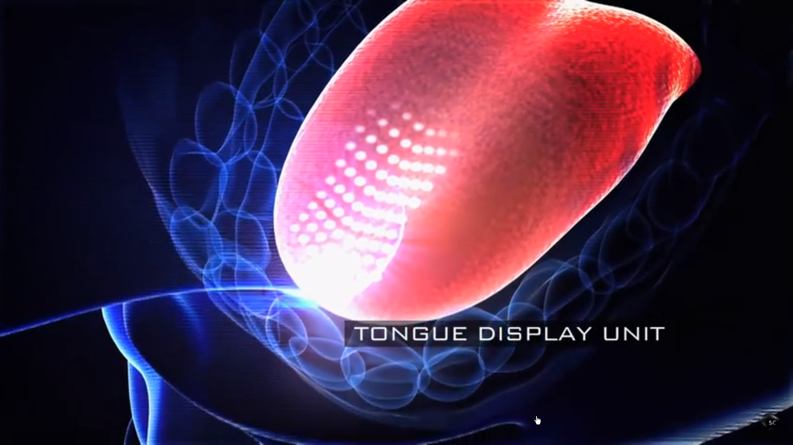
How it works?

Slide 6
Why device should be placed on tongue?
Sensitivity
Electrical stability
If we compare tongue with other parts of body well
notice that the skin of tongue is more sensitive than any
other body part. Large numbers of nerve fibers are
present on the tongue and there is no stratum corneum
(outer layer of dead skin cells) on the tongue which would
otherwise act as an insulator. To stimulate nerve fibers in
tongue we require not if 5-15V which is much less as
compared to any other body part .Also saliva in our mouth
which surround our tongue acts as an electrolyte and
helps to maintain constant flow of current between the
electrode and skin tissue. Moreover the area of cerebral
cortex which helps to interpret the data from tongue is
also larger than any other body part. Thus tongue is the
best choice so far.

Slide 7
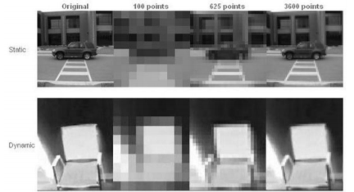

Testing of brain port
The images here demonstrate how information from the video camera is represented on the tongue. Today’s prototypes have 400 to 600 points of information on a ~3cm x 3cm tongue display, presented at approximately 30 frames per second, yielding an information rich image stream. Research in this field suggests that the tongue is capable of resolving much higher resolution information and we are currently working to develop the optimal tongue display hardware and software.

Slide 8
Limitations:
1. This technology can’t be adapted to work on senses the brain doesn’t already have.
So, the research center is trying to implement this kind of people also.
2. The Brain Port requires training the brain incrementally using daily practice sessions.
3. When it comes in market its cost is around $10,000. So it cannot be afforded by common people.
4. Occasionally it will produce weak metallic taste sensations, a minor side effect.

Slide 9
Thesis statement:
Seeing happens in the brain, where visual information is processed. So if a person’s eyes don’t work, visual information can be channeled to the brain through another body part – like the tounge.

Slide 10
THANK YOU

